Slide 1
Text Mining techniques on Polish National News
Michel Voss

Slide 2
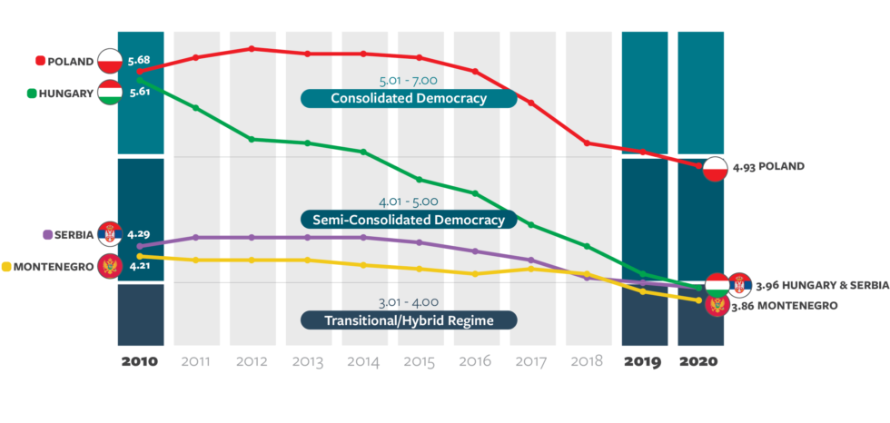
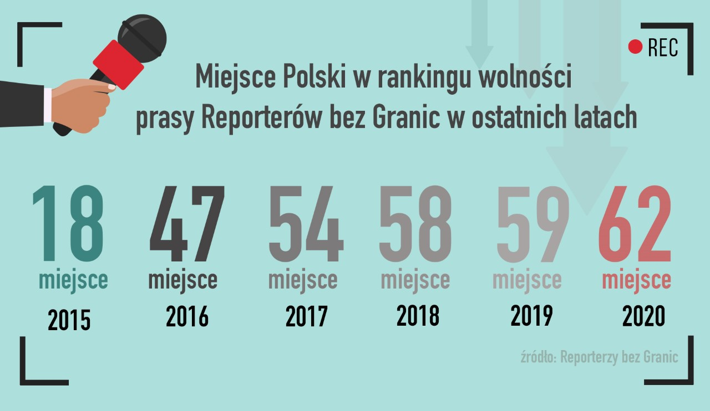
Why?
Polish Freedom House index

Slide 3
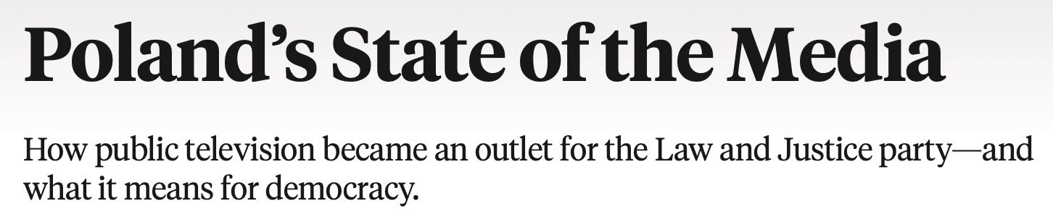
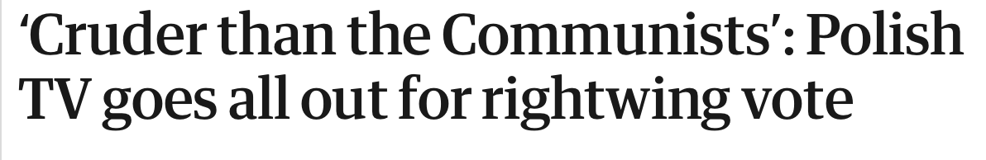



Slide 5



Goal:
Analyse Polish National News on a daily basis
To control the influence of the Goverment

Slide 6



How to gather the data?

Slide 7


Lastest technical setup
Finally I decided to use the following setup:
Raspberry Pi 4B 4GB RAM with a 32GB Micro SD
TV HAT tuner DVB-T
Tvheadend

Slide 8
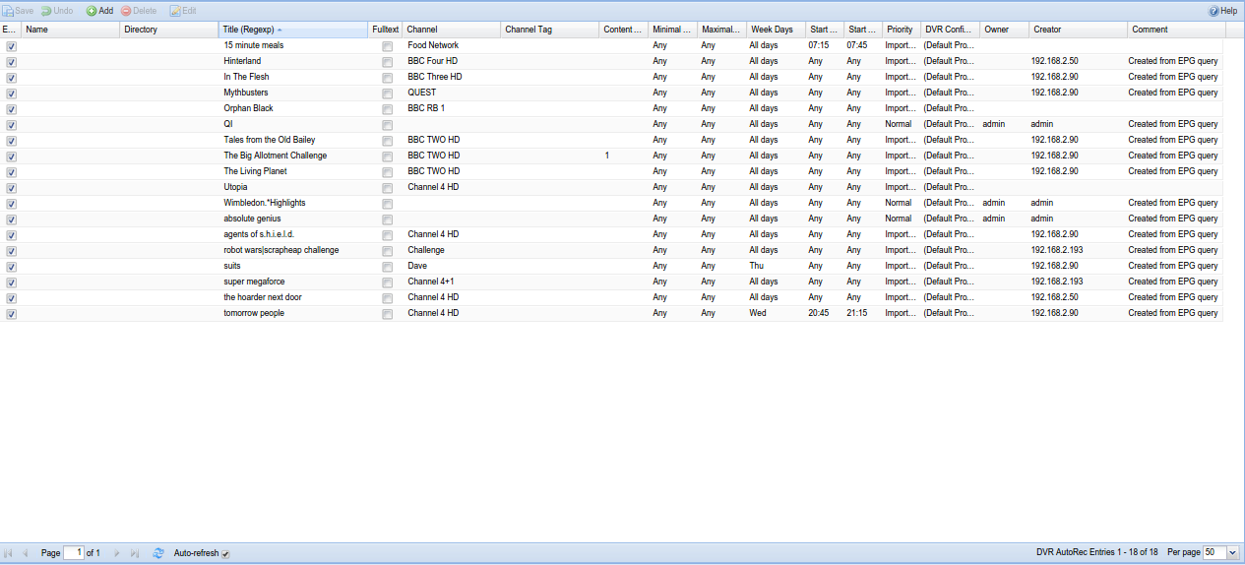
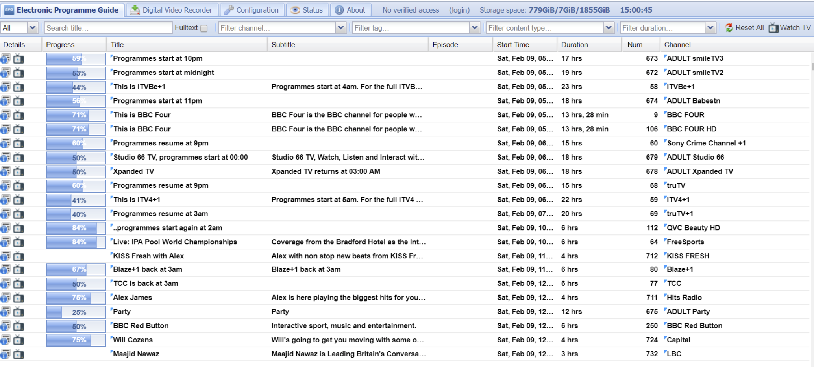
Tvheadend

Slide 9
CCextractor
„A tool that analyzes video files and produces independent subtitle files from the closed captions data.” - https://www.ccextractor.org/
Supported countries: - American TV captions (CEA-608 is well supported, and CEA-708 is starting to look good) - European Teletext - European DVB - Brazilian ISBD - DVD - MXF
Missing: - DTMB (Chinese)

Slide 10
Libraries and sets used:
Stopwords - https://github.com/bieli/stopwords
Stemming - https://github.com/MarcinKosinski/trigeR5/tree/master/dicts
Subtools – extract subtitles from .ts files
Tidytext
Topicmodeling
Ldatuning
Tidyverse

Slide 11
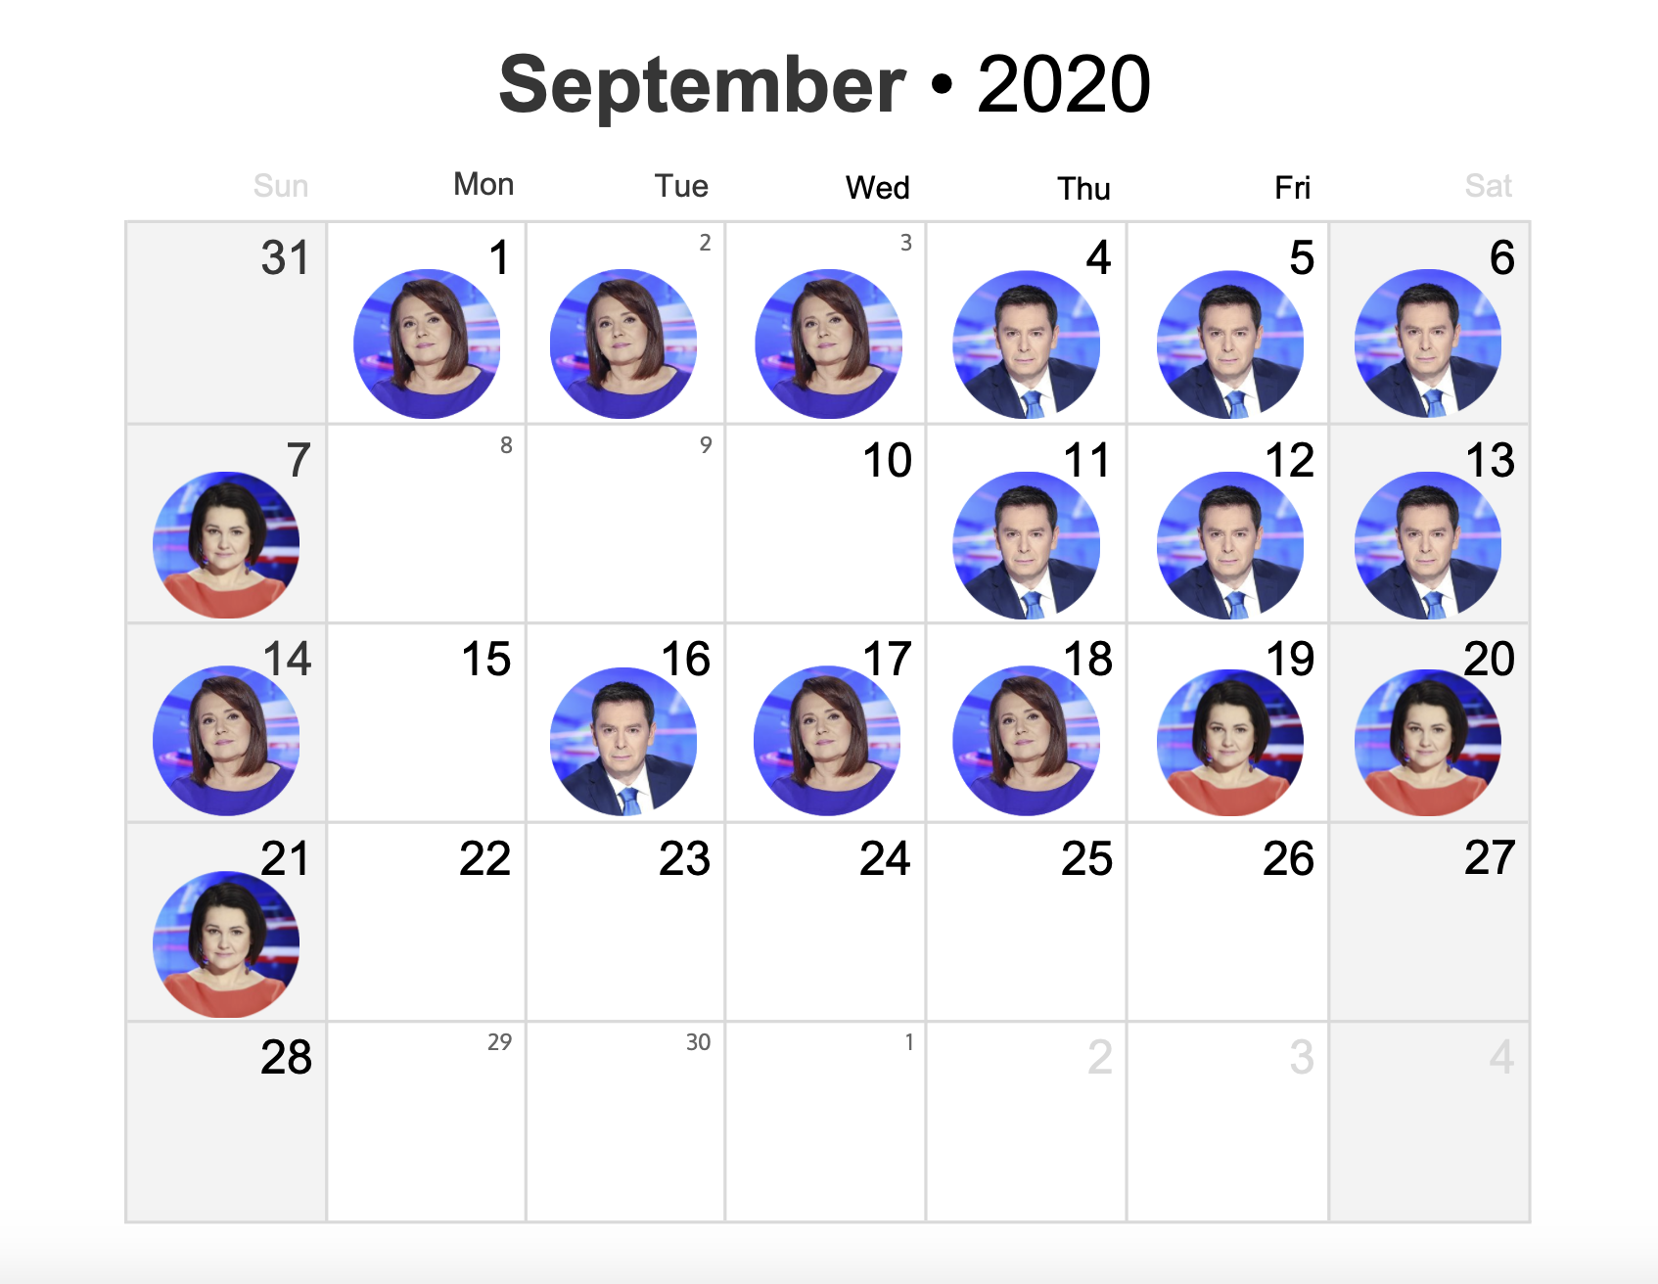

Slide 12
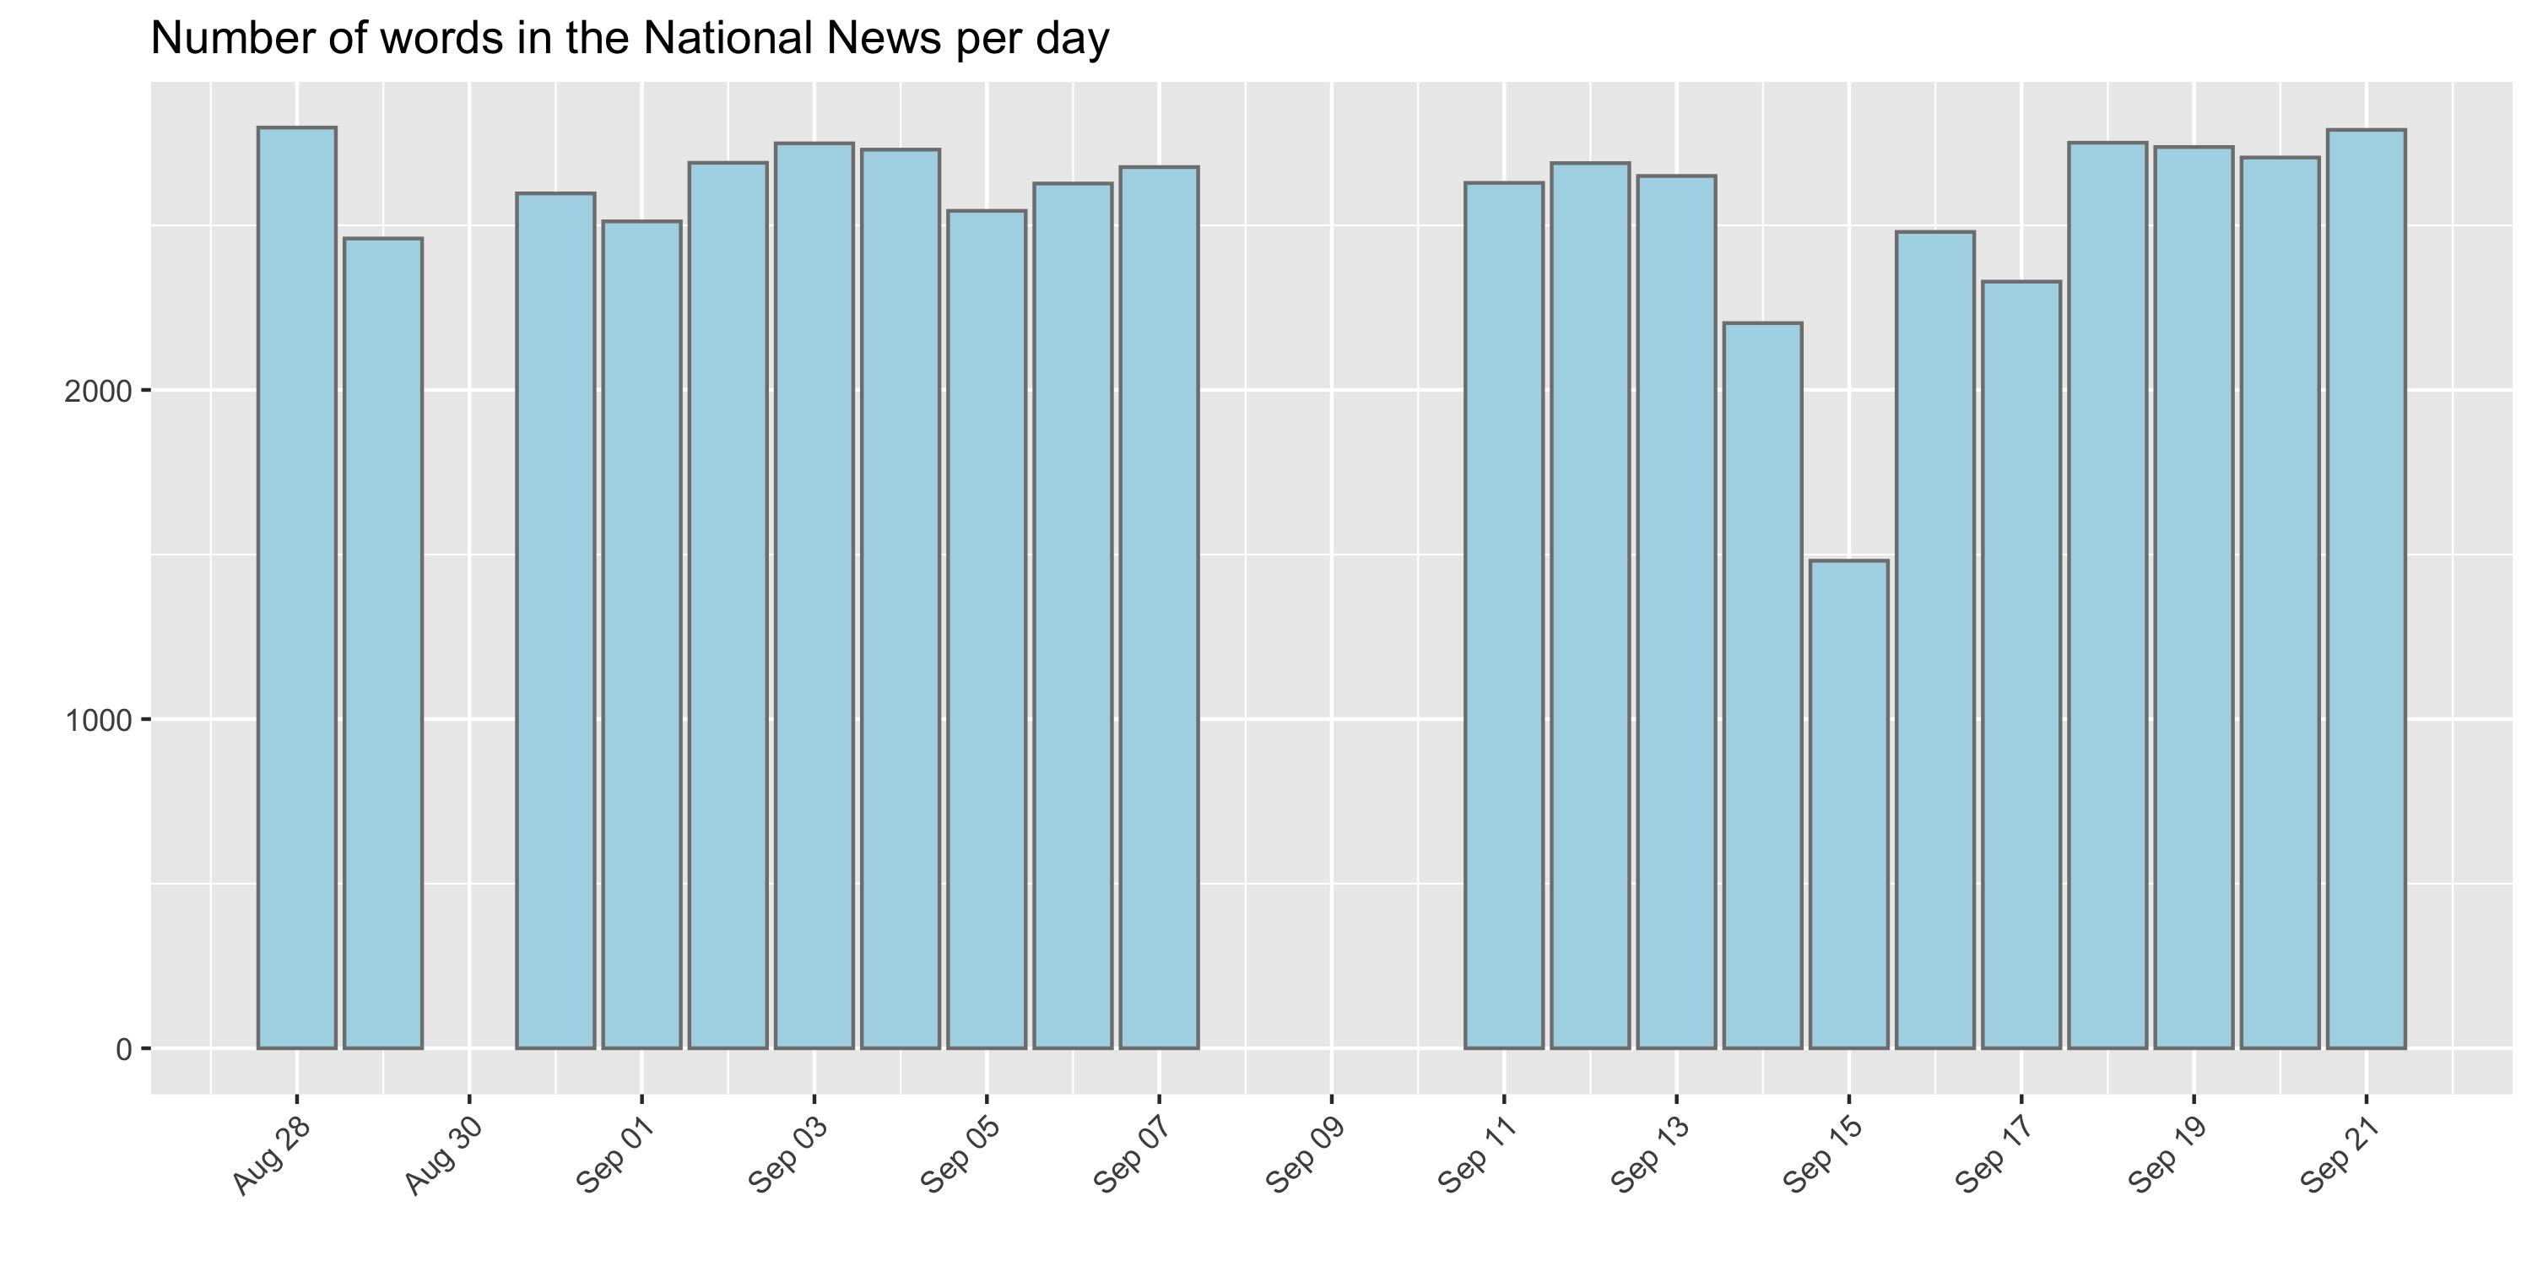

Slide 13
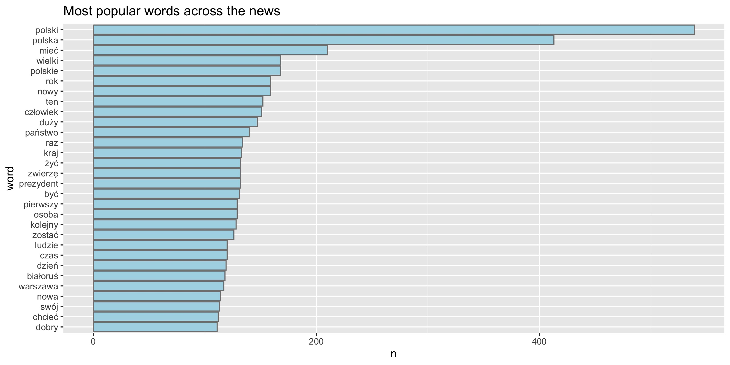

Slide 14
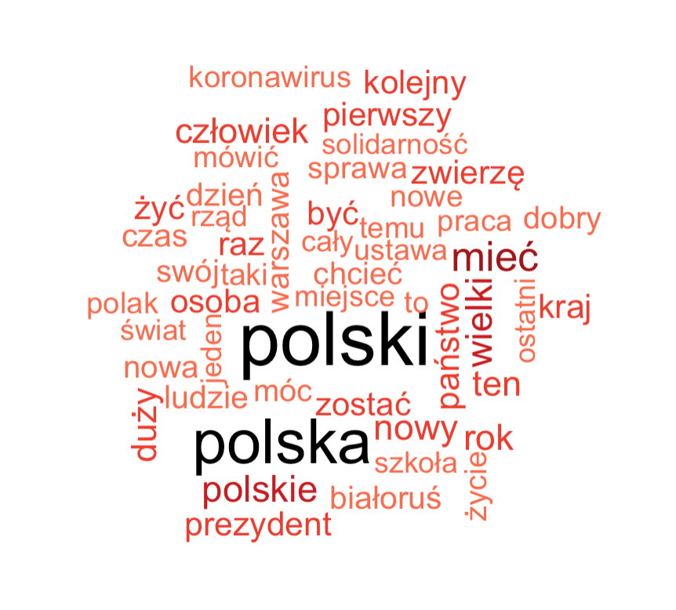

Slide 15
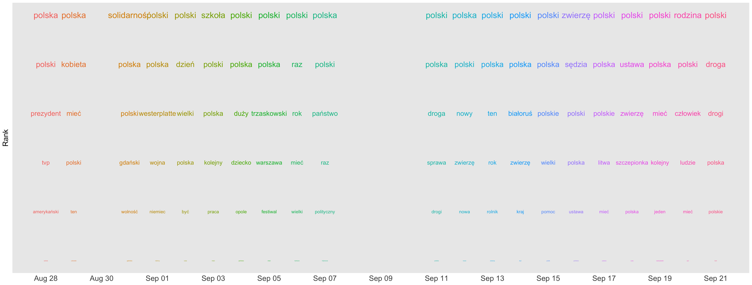

Slide 16
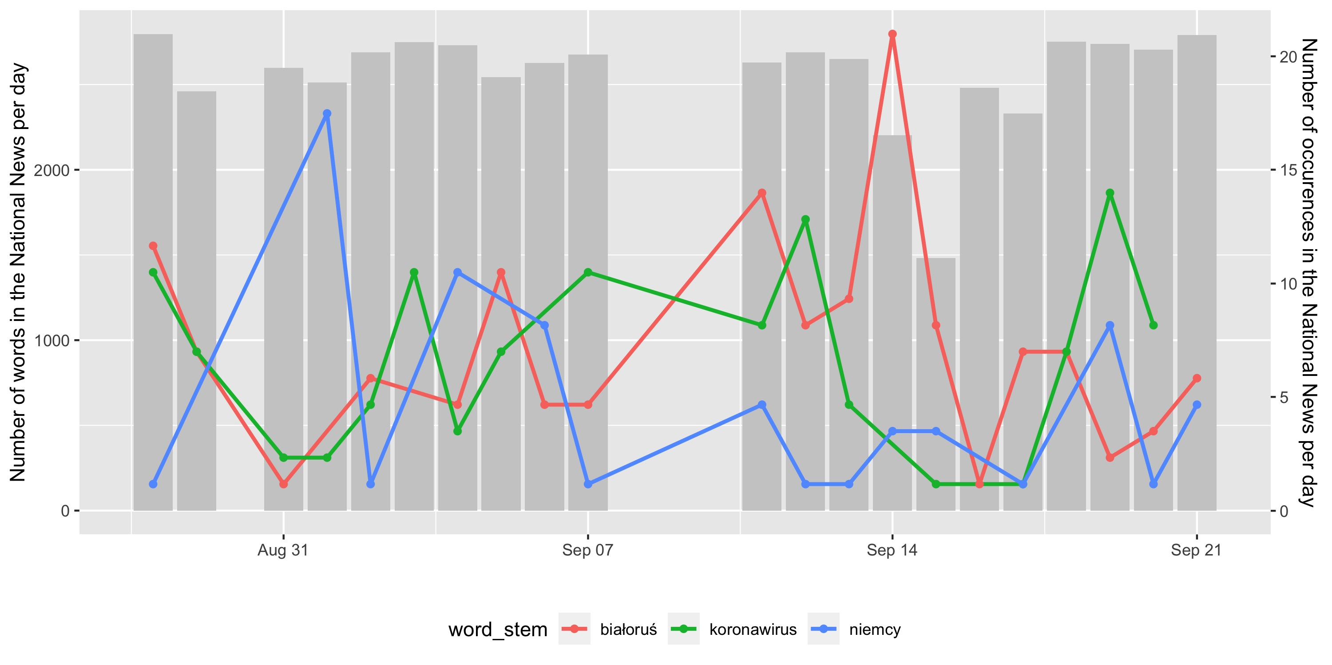

Slide 17
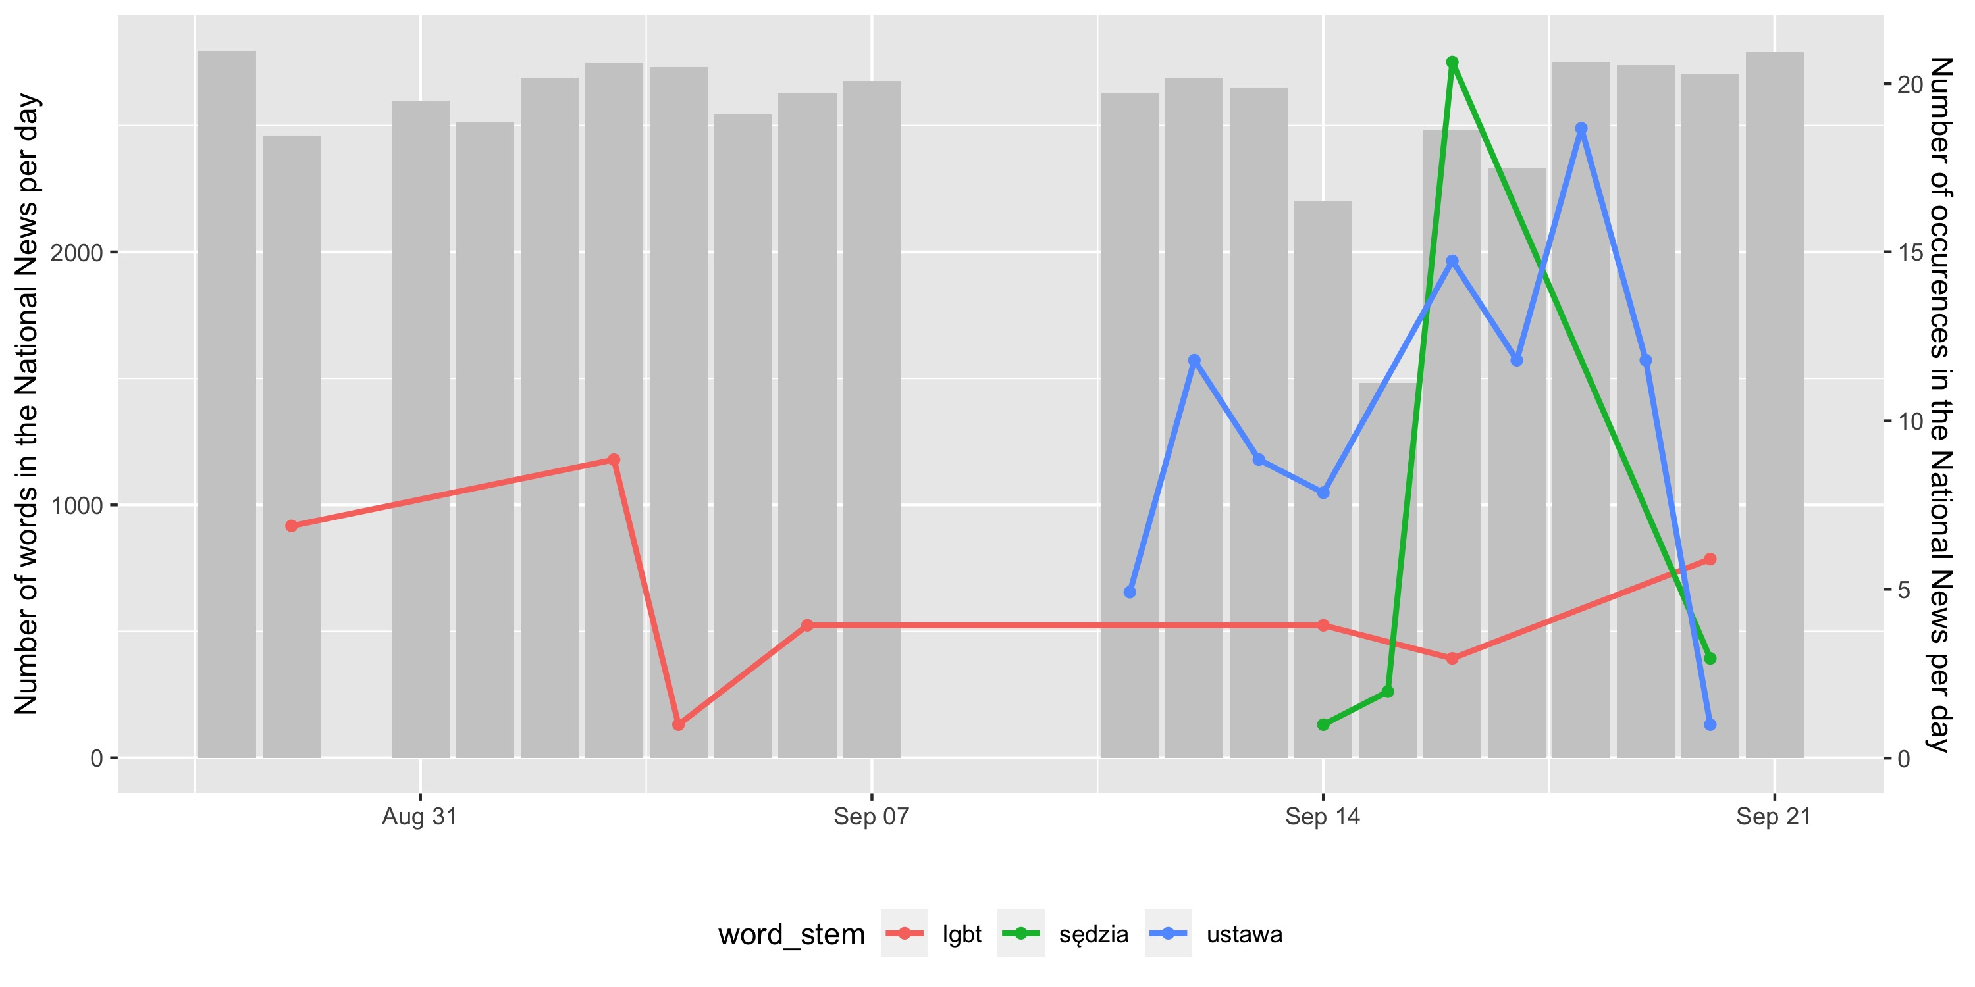

Slide 18
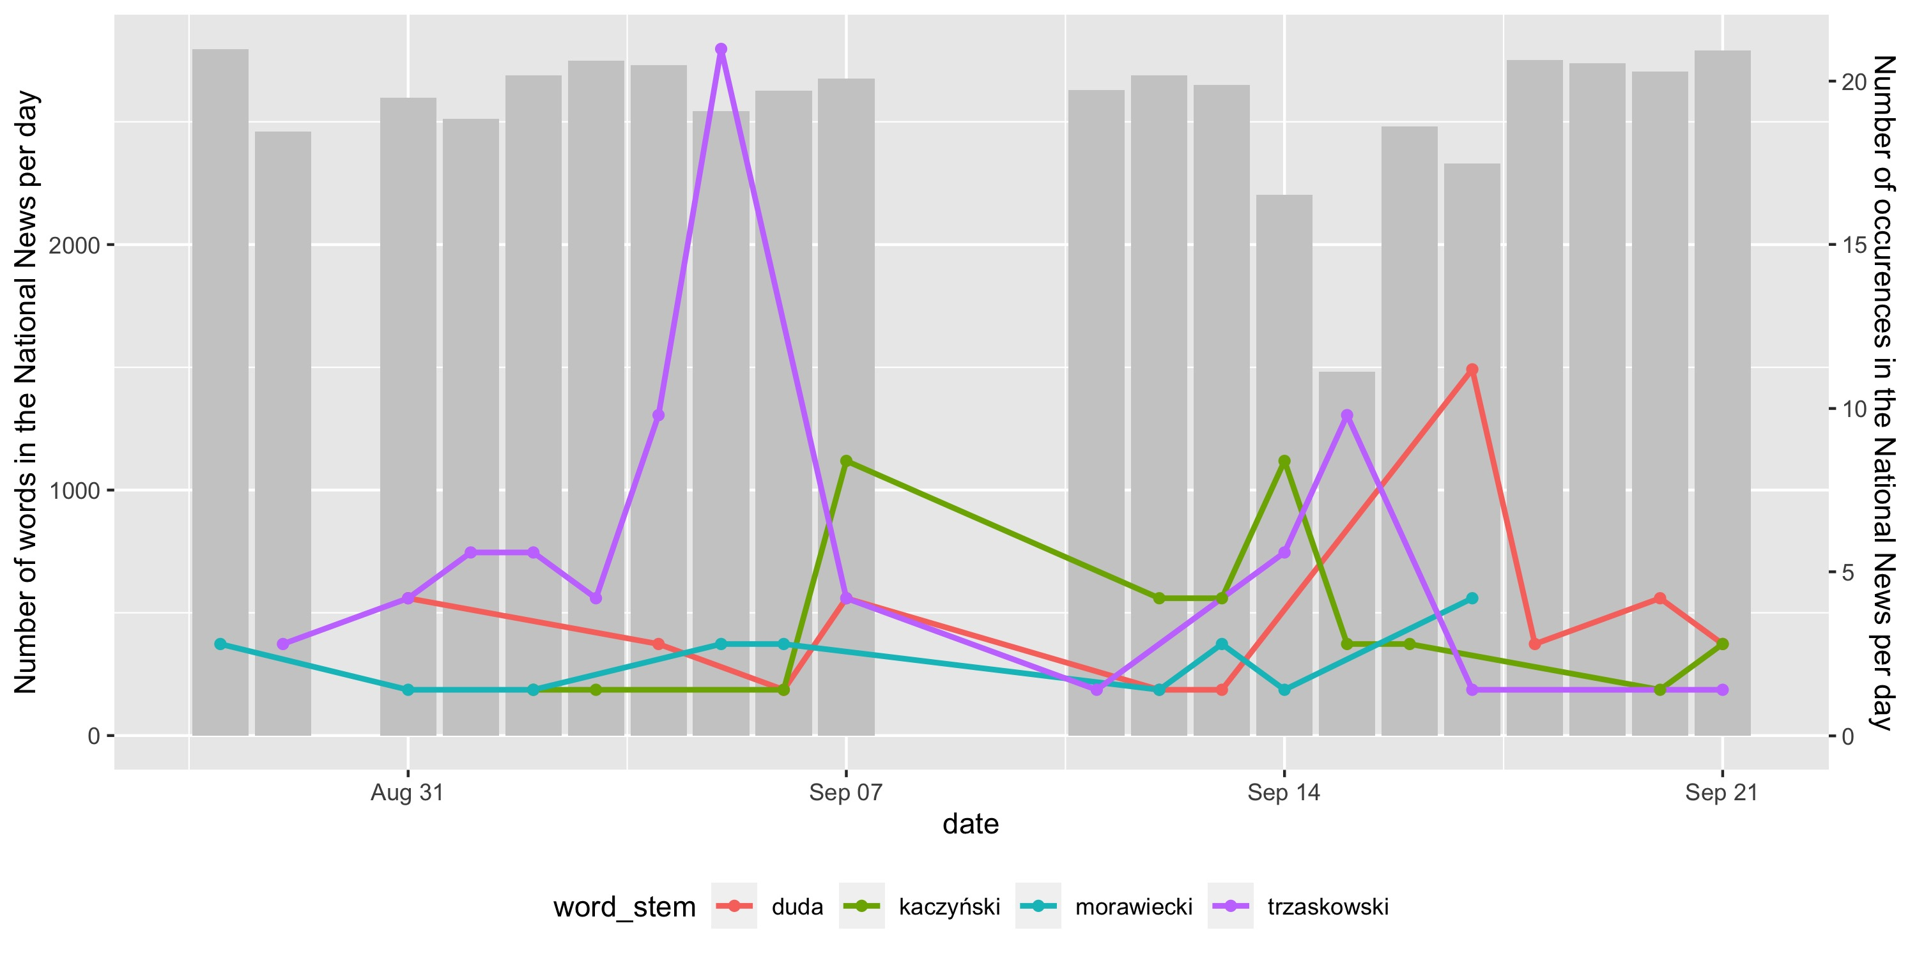

Slide 19
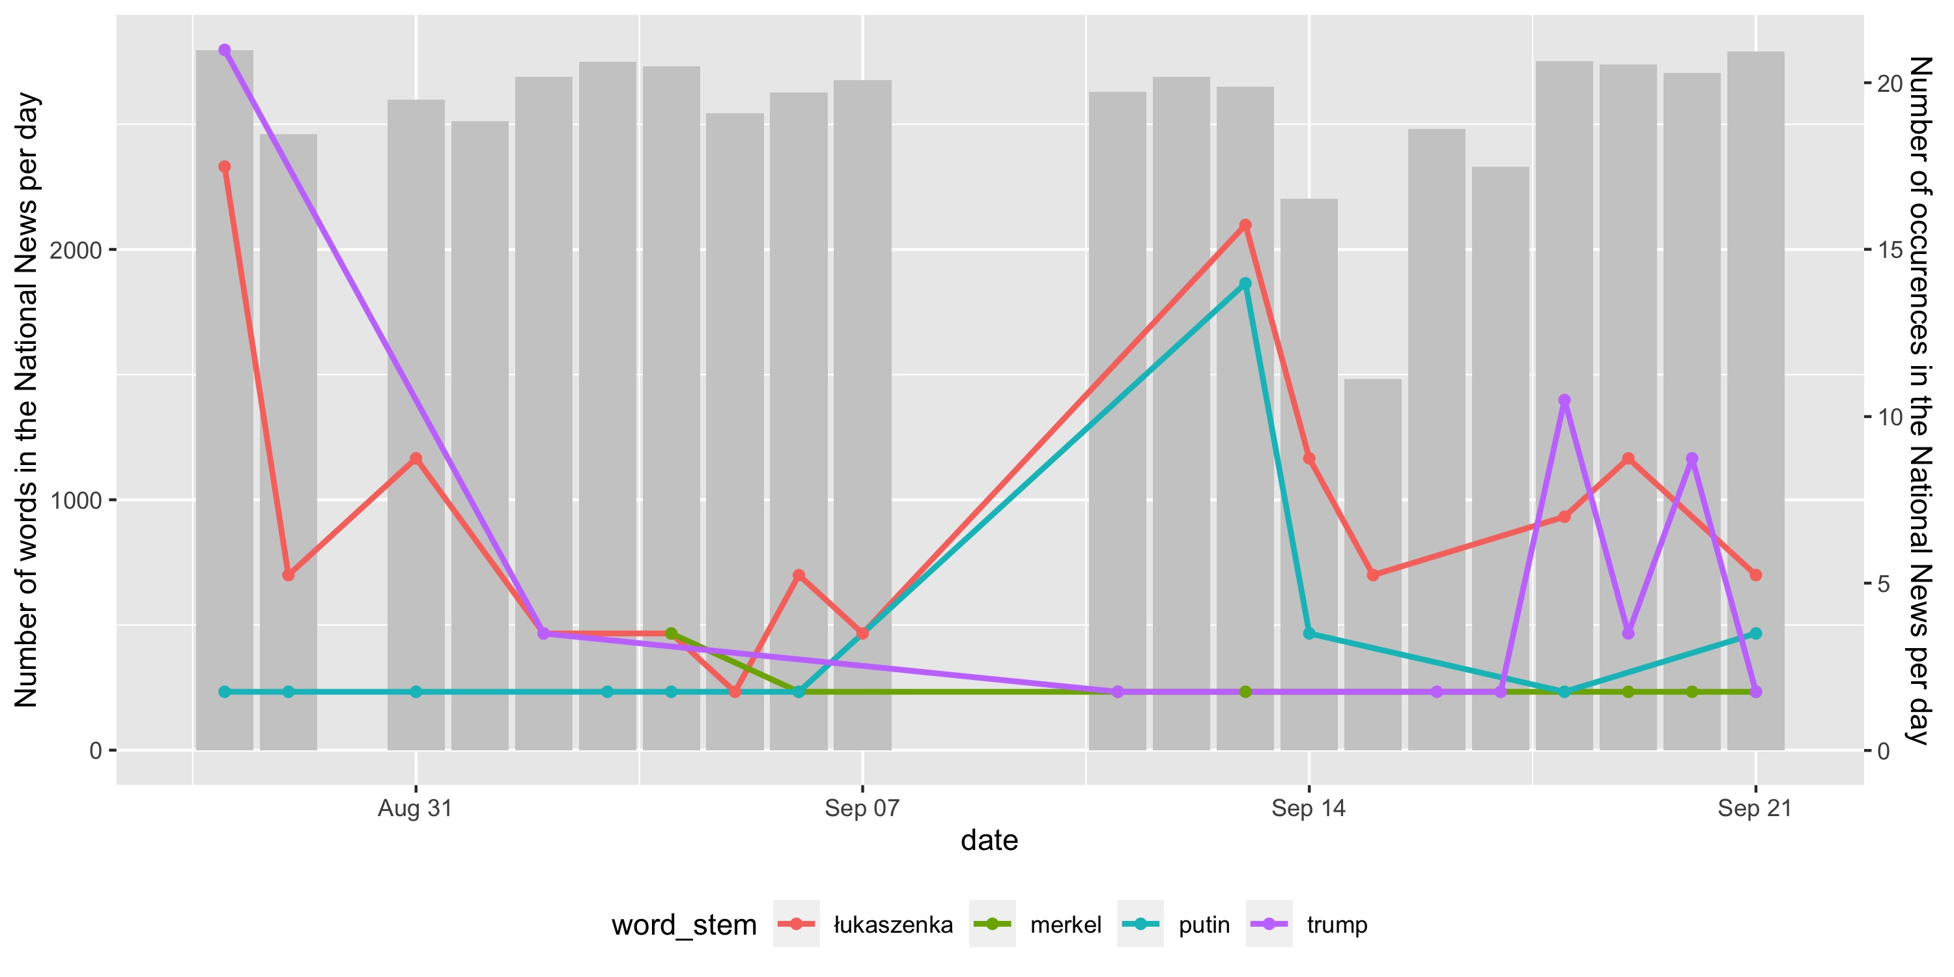

Slide 20
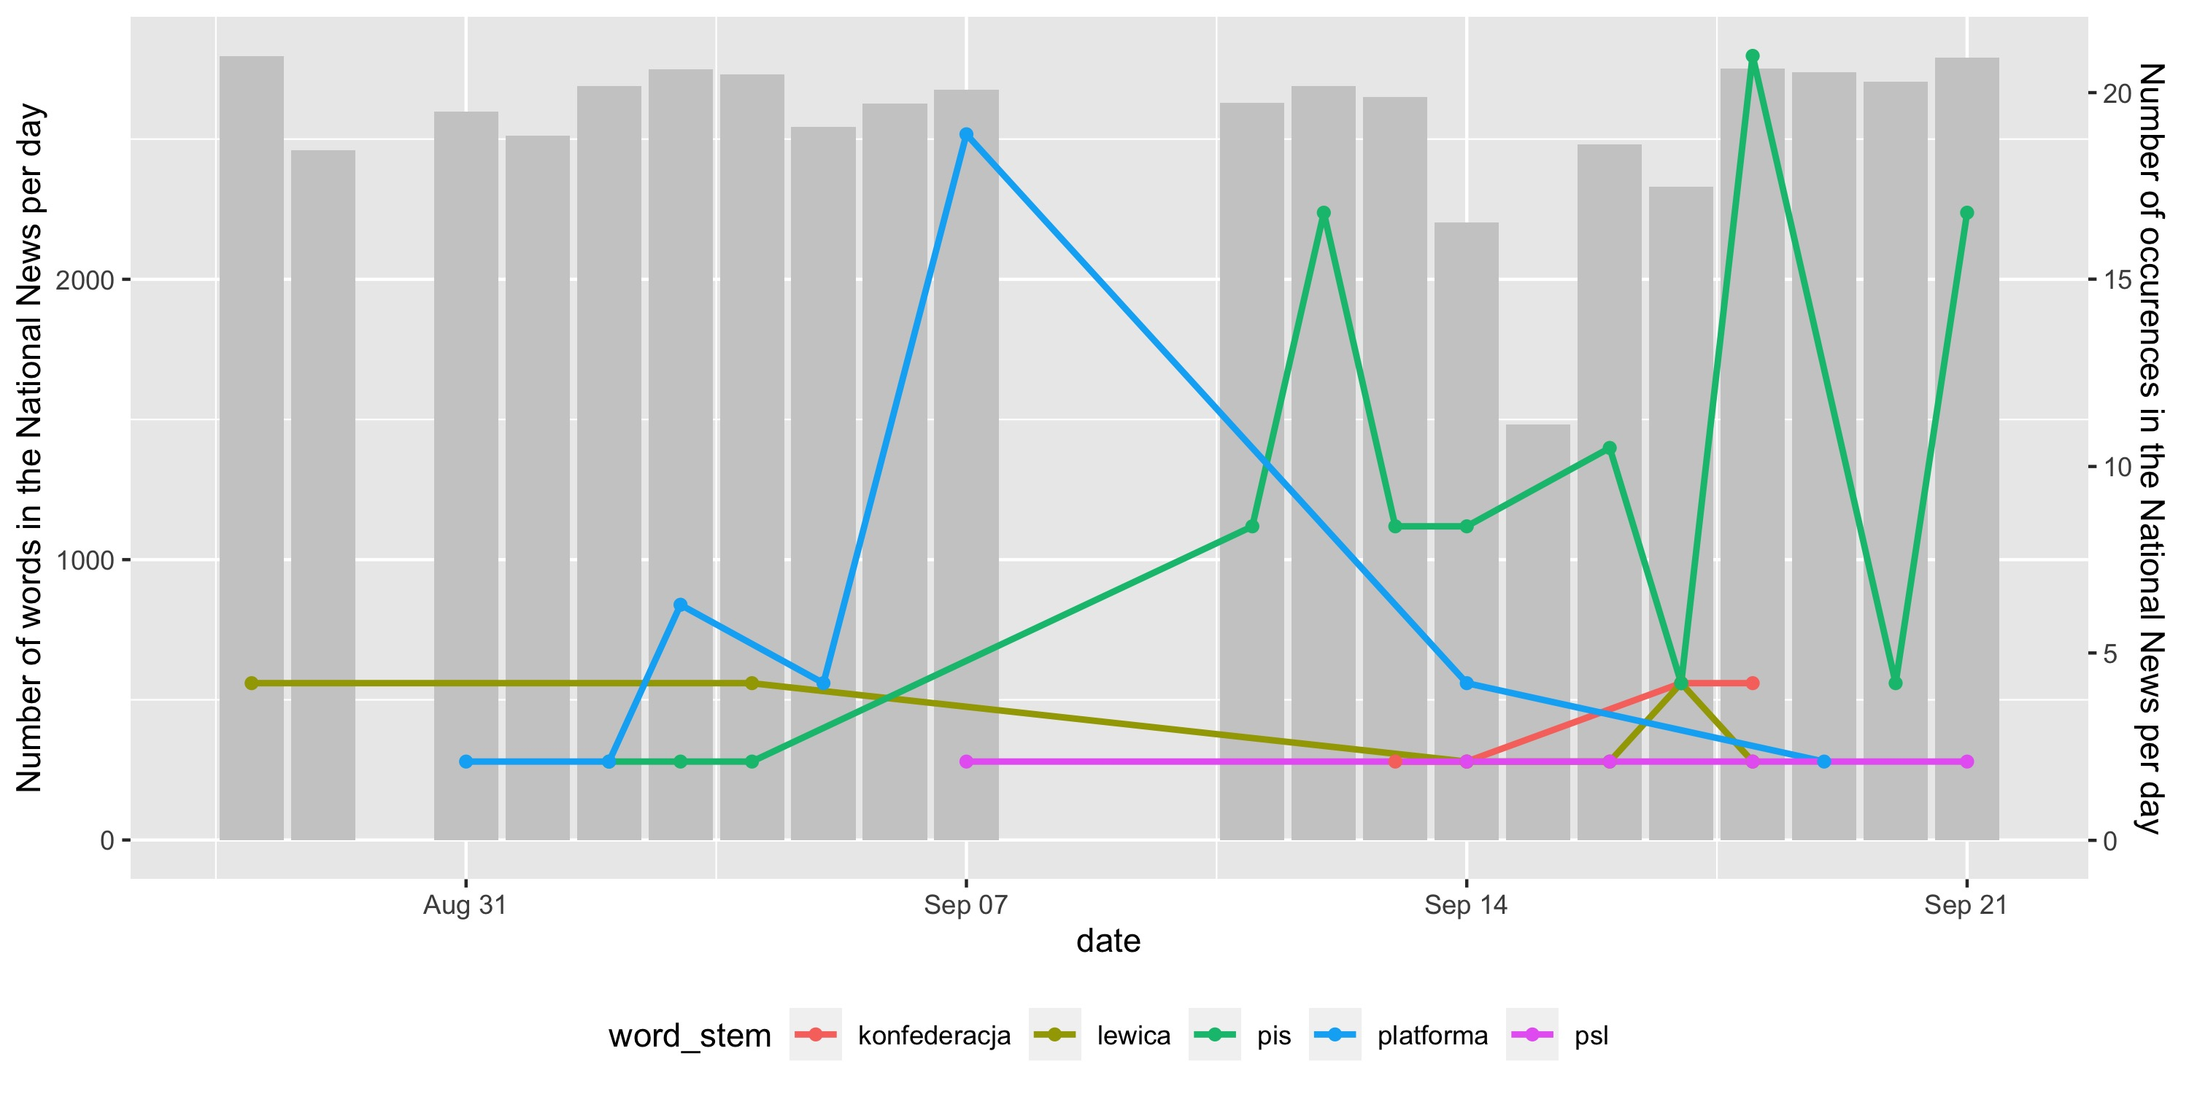

Slide 21
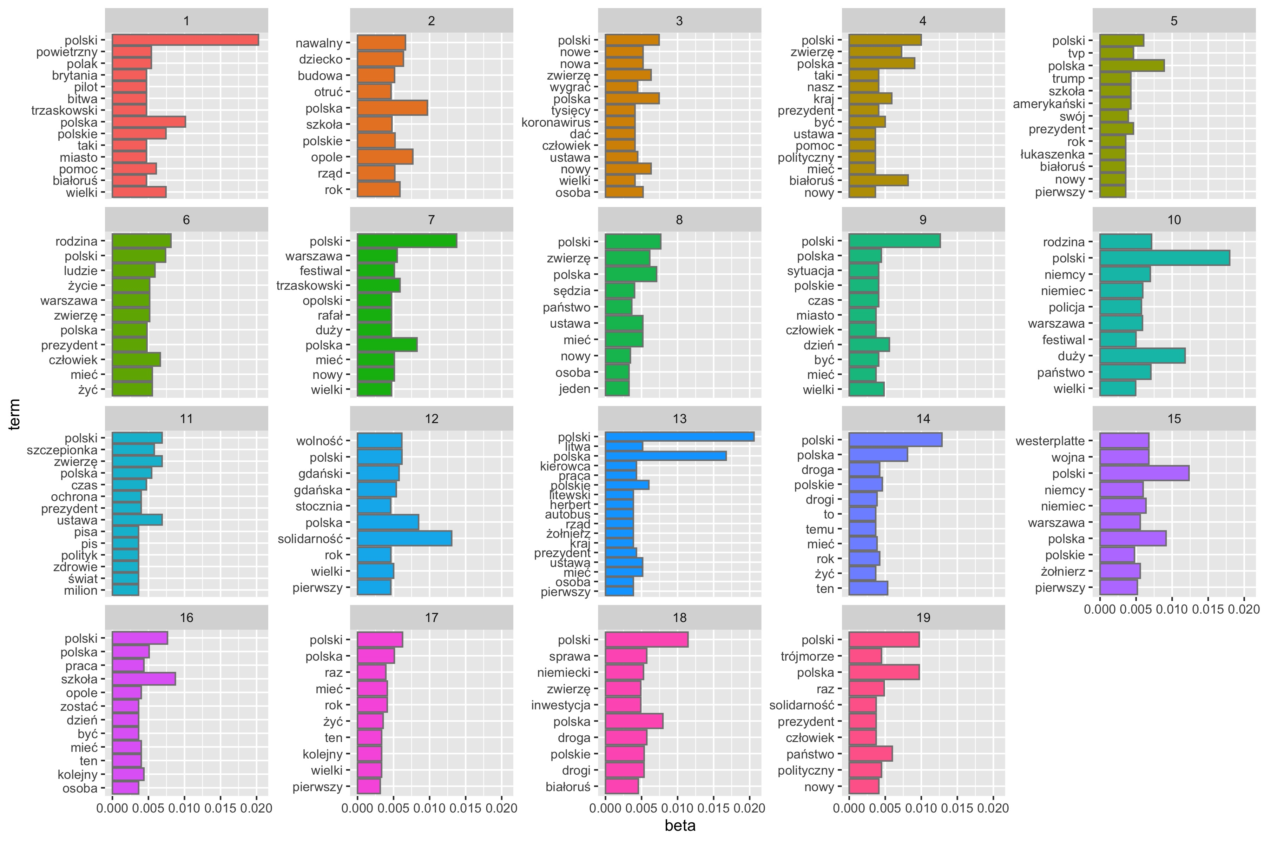
LDA

Slide 22
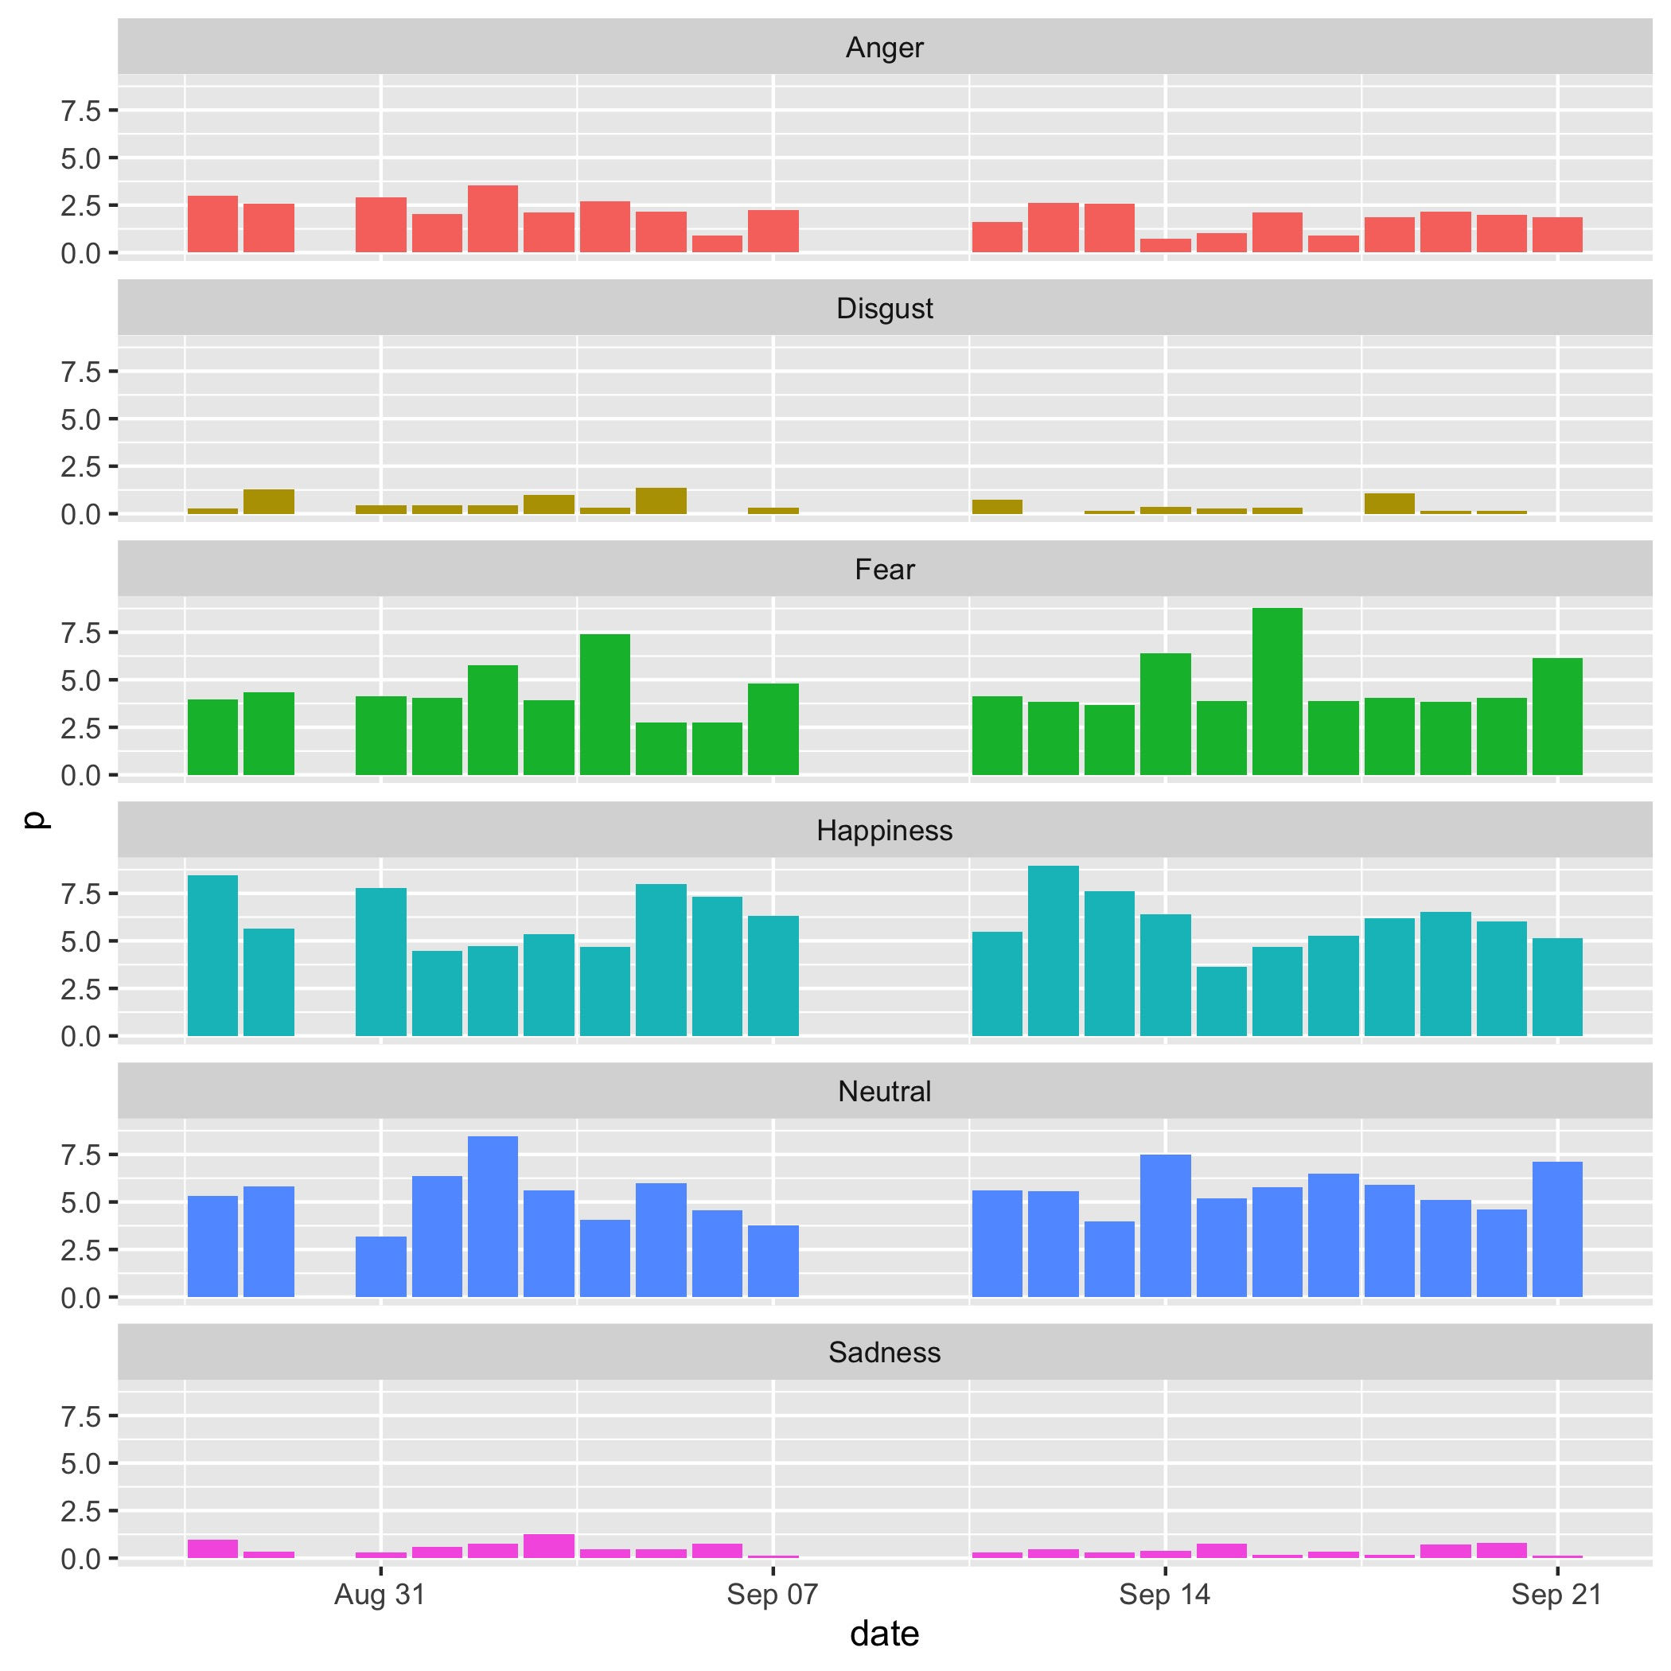
Sentiment

Slide 23
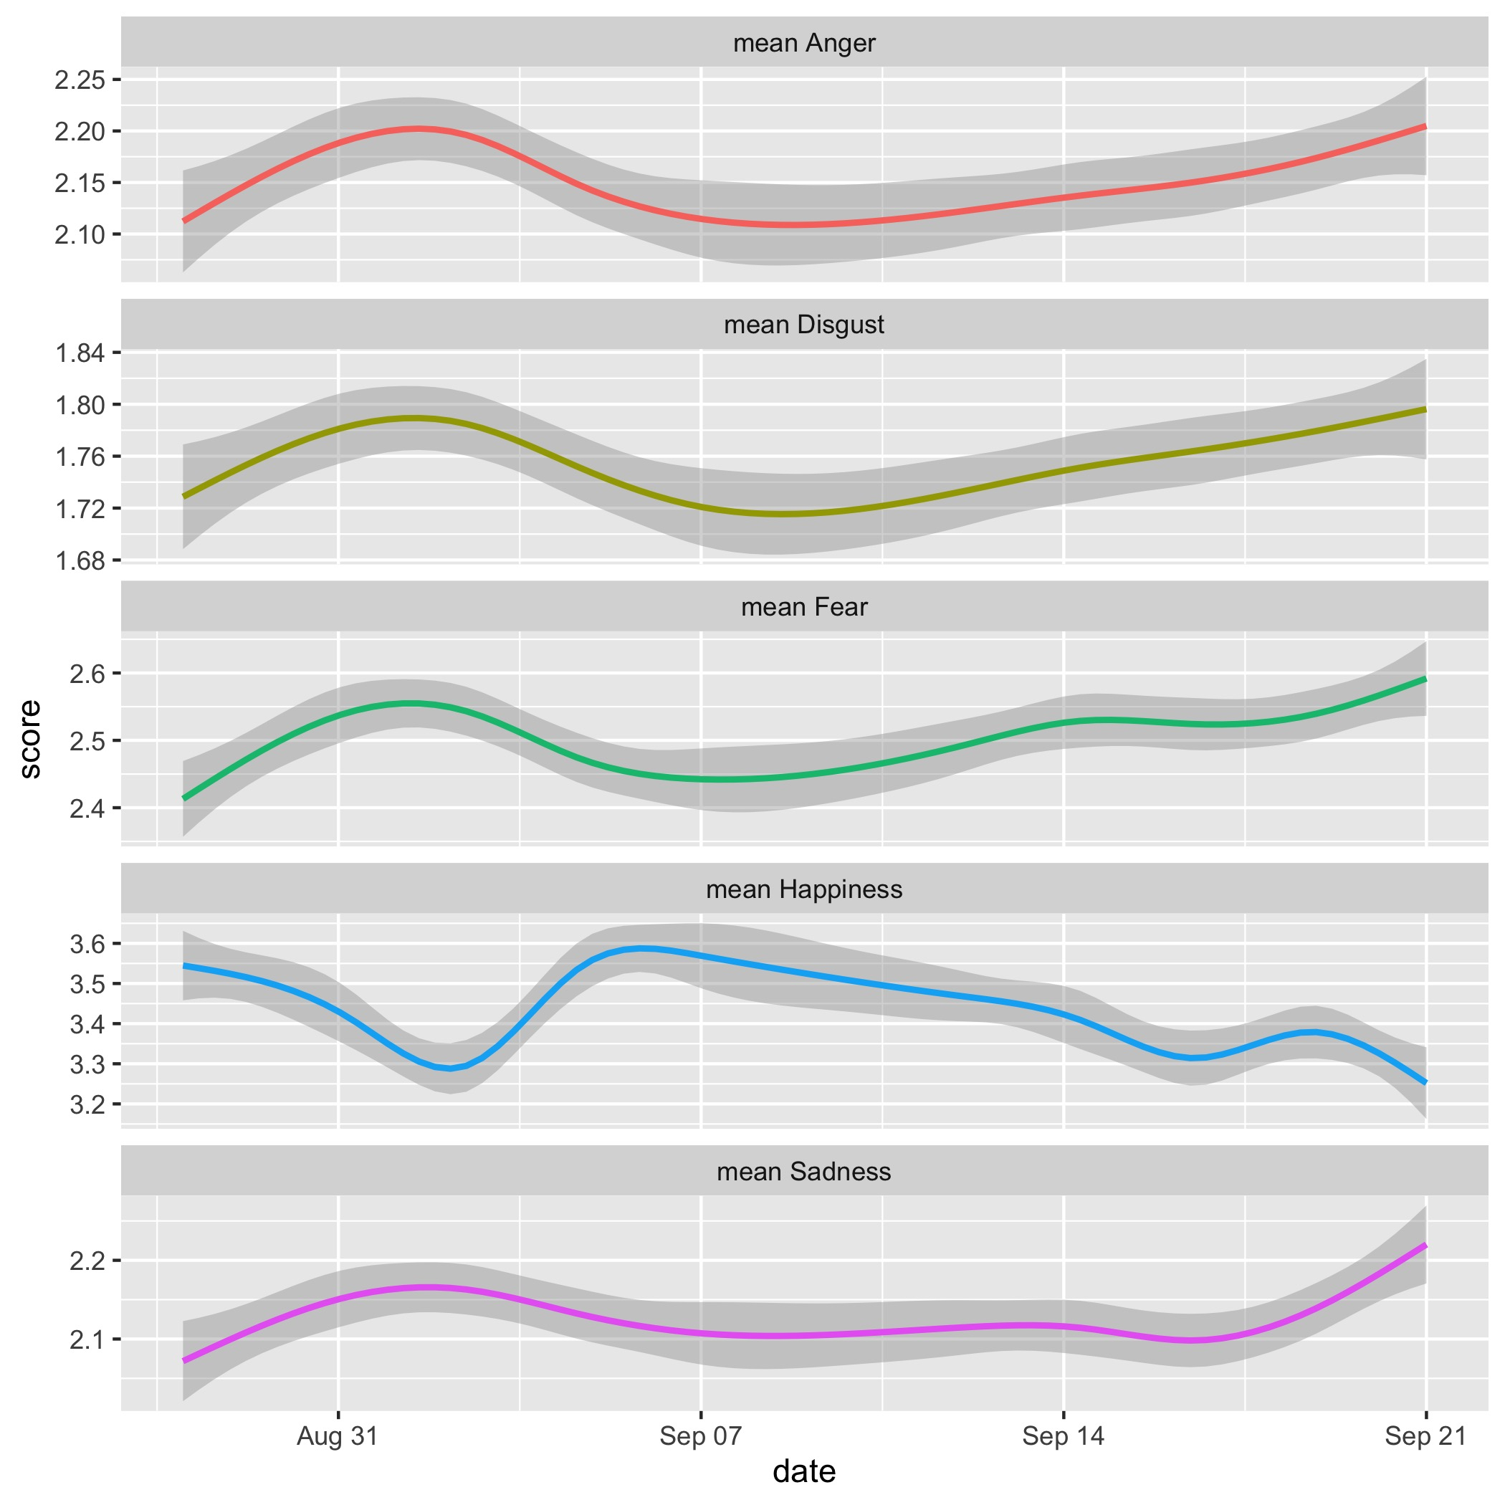

Slide 24
Lessons learned
A solid infrastructure is everything
Try to automate as much as you can
Ask as much questions as possible

Slide 25

Thanks!
Thanks to Łukasz Prokulski

